Slide 1

Residual Stress in Materials
Residual stress is the internal stress distribution locked into a material through the manufacturing process, post treatment or by cyclic loading.
Residual stress effects:
• Low cycle and high cycle fatigue performance
• Distortion
• Peen forming (controlled distortion)
• Fretting
• Stress corrosion cracking (SCC) and hydrogen initiated cracking (HIC)
• Crack initiation and propagation. (Damage tolerance)

Slide 2

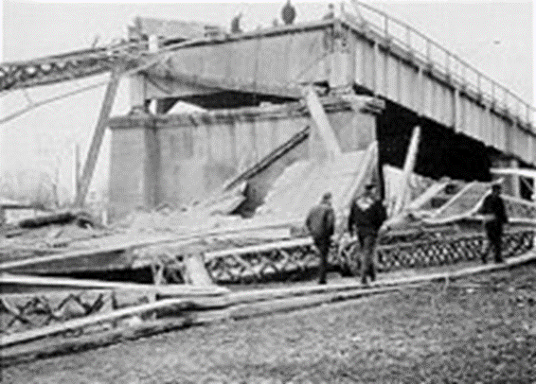
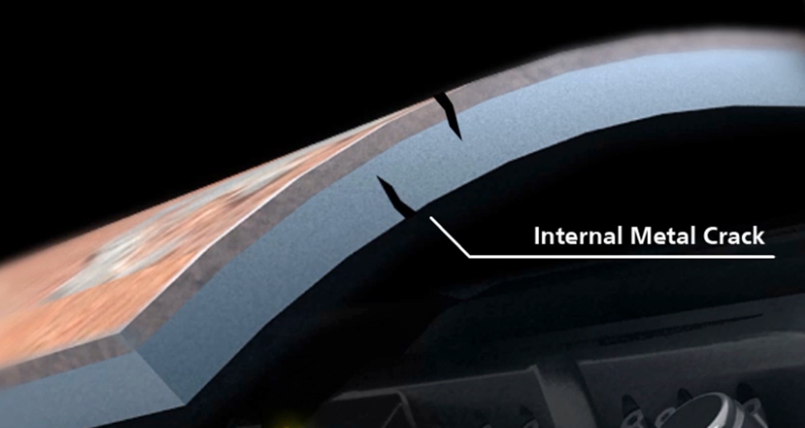
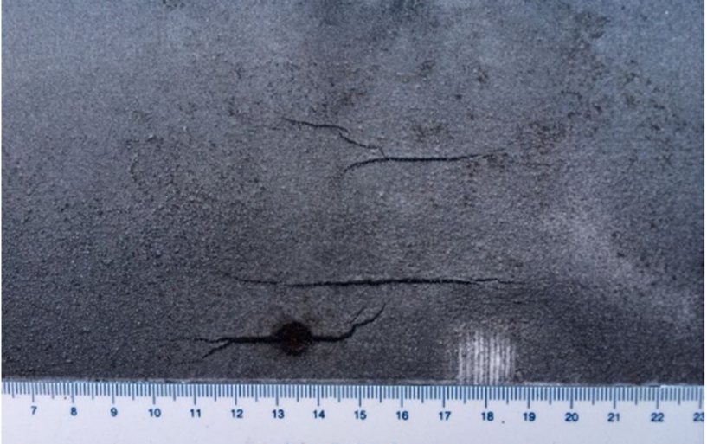
What happened with residual stress?
The collapsed Silver Bridge, as seen from the Ohio side, the failure was exacerbated by a high level of residual stress in the eyebar.
Resulting Metal Cracks

Slide 3
Residual Stress release through Ultrasonic Peening
Peening a surface spreads it plastically, causing changes in the mechanical properties of the surface. Peening is often called for in aircraft repairs to relieve tensile stresses built up in the grinding process and replace them with beneficial compressive stresses to avoid the propagation of micro-cracks from a surface.
Advantage of Ultrasonic Peening:
- No expensive transport costs
- Workpieces remain in your house
- Easy to use
- Flexible dates
- Environmentally friendly
- Cost effective
- Simultaneous control of your work pieces
- A successful relaxation process in 30 minutes
performed per workpiece

Slide 4
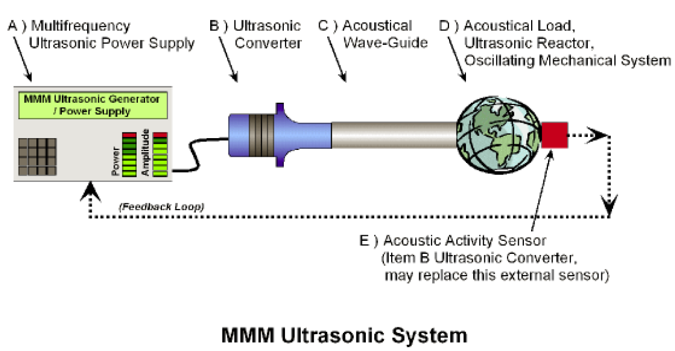
RSRM Ultrasonics Technologies
Innovative multifrequency, multimode, modulated (MMM) technology has been successful developed uniquely by RSRM Ultrasonics to release residual stresses in any irregular metal parts and many other applications

Slide 5
RSRM Ultrasonics Technologies
RSRM Ultrasonics offers a unique method for the identification, removal and monitoring of residual stresses in both ferrous and non-ferrous metals.
RSRM high-power ultrasonic generator
Indication of stresses in welded structure

Slide 6
Measurement Technologies of Residual Stress in metals

Slide 7
Intellectual Properties of RSRM Ultrasonics
RSRM Ultrasonic Technology has developed innovation in “Agitation of large and Arbitrary Shaped Metal Objects”, “A new and unique method for Biofouling prevention” and as well as for a “New and Novel Asset Integrity Management System”
Existing Patents
2000 EP 1 060 798 A1 “Unidirectional single piston ultrasonic transducer“
2002 EP 1 050 347 A3 “Ultrasonic transducer”
2002 EP 1 238 715 A1 “Multifrequency ultrasonic structural actuator”
2004 EP1405679 A1 “Linear array of sonic and ultrasonic transducers, assembled in the form of complex, integral tube resonator”
Patent Applications
2017 RSRM-PA-2017-08 “A new and unique method for the production of nano/micro sized particles”
2017 RSRM-PA-2017-10 “Resonation of Large and Arbitrary Shaped Objects”
2017 RSRM-PA-2017-11 “New Method for the prevention of Biofilm and Algae formation”
2018 RSRM-PA-2018-02 “An Acoustic Transducer Antenna”

Slide 8
Applications in petroleum industrial
Oil & Gas pipelines and structures are prone to failure due to long standing residual stresses caused by loading as well as from initial welding procedures.

Slide 9
A new and unique method for Biofouling prevention
The patented method reduces fouling on underwater structures, through the use of acoustic vibration / cavitation to destroy, denature and discourage attachment of algae and single-celled organisms. The novel method is far superior to any currently available technology, be it chemical or ultrasonic based.

